Slide 1
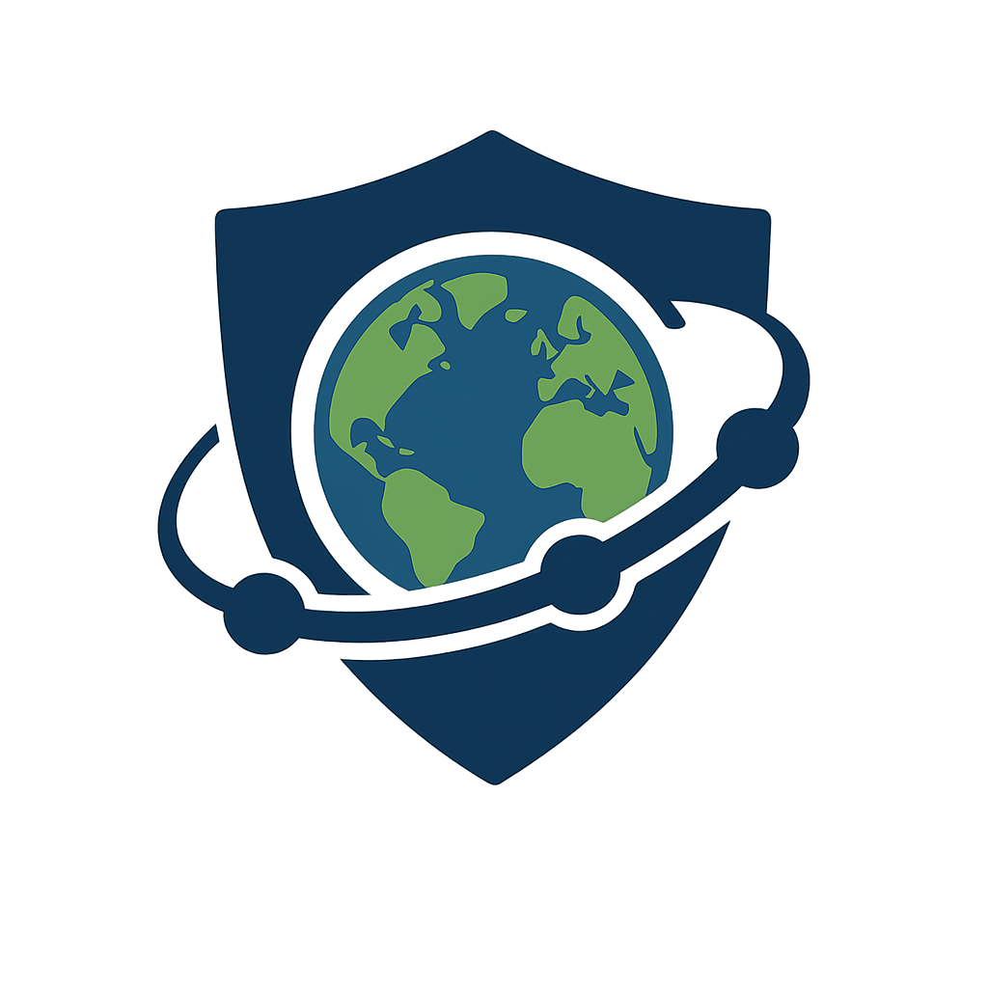
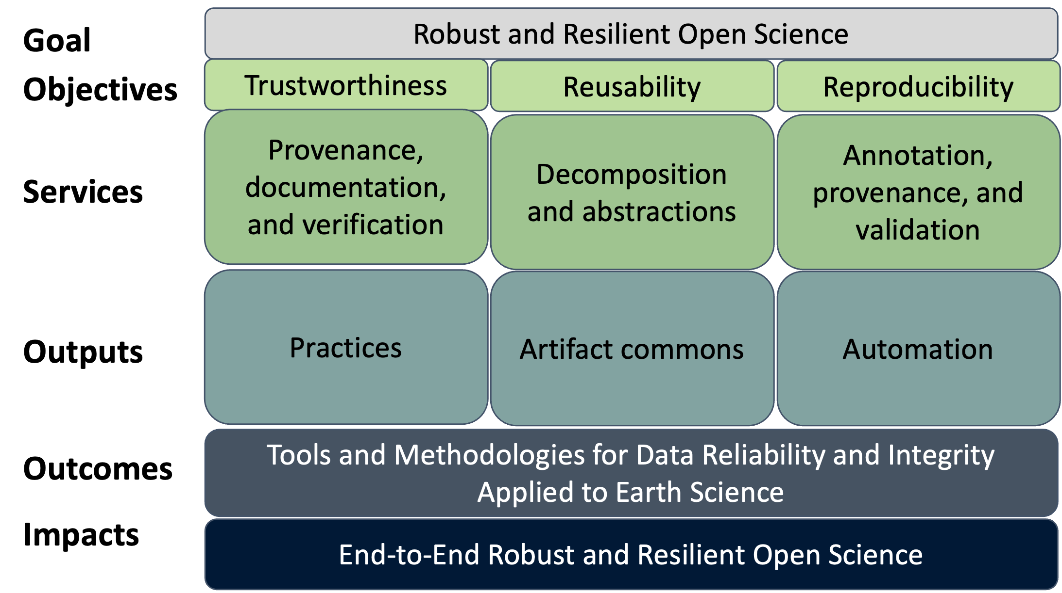
SAFARI: Scientific Analytics, Forensics, and Reproducibility for
Workflows in Cyberinfrastructures PI: Michela Taufer (U. Tennessee, Knoxville) Co-PIs: Ewa Deelman (U. Southern California)
Cybersecurity Innovation
Embed forensic data analytics directly into workflow systems (Pegasus); ensure trustworthiness, reusability, and reproducibility (TR&R) of scientific workflows; and automate data provenance, validation, and integrity checks for end-to-end security.
Modularize workflows into containerized components for explainability and reuse; and establish forensic analytics as a core CI service, setting new standards for open science.
Approach For Transitioning the Innovation
Provide interoperable building blocks (artifacts, toolchains, automation, practices).
Deliver containerized workflow modules for portability and reusability.
Integrate automated forensic verification frameworks directly into Pegasus workflows.
Train students and researchers through hands-on forensic CI services.
Engage with communities (ACCESS, SC, PASC, AGU, AAAS) to build adoption pathways.
Safari integrates forensic data analytics into the Pegasus Workflow Management System to enhance trustworthiness, reusability, and reproducibility (TR&R) of scientific workflows. By modularizing workflows, embedding provenance and verification, and automating integrity checks, SAFARI ensures results are reliable, secure, and explainable across high-throughput computing (HTC) platforms, with a strong emphasis on Earth science.
Benefits to Scientific Cyberinfrastructure
Impact Earth science researchers (drought, wildfire, flood prediction), plus broader domains like bioinformatics, materials science, and physics.
Establish trust in workflows by ensuring data integrity, reproducibility, and reusability—raising the standard for open and explainable science across HPC/HTC platforms.
Risks Versus Potential For Advances
Risks: Integration of forensic analytics may introduce overhead or complexity; adoption requires cultural and technical shifts in workflow communities.
Evaluating and Demonstrating Transiton
Num. of workflows with embedded forensic analytics with trustworthiness (provenance integrity, validation accuracy) and reproducibility across HPC/HTC platforms. (Metrics)
Adoption and reuse of components by Earth science and cross-domain users, with training outcomes measured by num. of students and early-career researchers engaged. (Metrics)
Open-source forensic workflow modules via Pegasus WMS GitHub, with documentation, tutorials, and training through ACCESS affinity groups and workshops. (Community Access)
Dissemination via SC, PASC, AGU, AAAS, and community platforms to ensure broad access and reproducibility. (Community Access)
Payoff: Sets a new benchmark for trustworthy, reproducible scientific workflows; enables cross-domain reuse, reduces costs; and builds workforce expertise in secure and explainable CI.
Programmatic Details
3-year project started on October 2021
Led by U. of Tennessee, Knoxville with U. of Southern California (ISI)
Unfunded collaborations with Earth science research groups and ACCESS communities
This material is based upon work supported by the National Science Foundation under Grant No. 2512345

